Slide 1

Notes:
Source: Pearson Edexcel GCSE (9–1) Design and Technology revision reference, uploaded as Year 10-11 Pearson Edexcel Design & Technology.pdf, sections 1.8 and 1.9, printed pages 26–30. Classroom adaptation of approved content. Images generated as illustrative teaching visuals. Technical clarifications: magnetism and corrosion vary between ferrous alloys; gsm measures mass per area; hardness differs from impact resistance; polished copper is reddish-brown.

Slide 2

Notes:
Source: Pearson Edexcel GCSE (9–1) Design and Technology revision reference, uploaded as Year 10-11 Pearson Edexcel Design & Technology.pdf, sections 1.8 and 1.9, printed pages 26–30. Classroom adaptation of approved content. Images generated as illustrative teaching visuals. Technical clarifications: magnetism and corrosion vary between ferrous alloys; gsm measures mass per area; hardness differs from impact resistance; polished copper is reddish-brown.

Slide 3

Notes:
Source: Pearson Edexcel GCSE (9–1) Design and Technology revision reference, uploaded as Year 10-11 Pearson Edexcel Design & Technology.pdf, sections 1.8 and 1.9, printed pages 26–30. Classroom adaptation of approved content. Images generated as illustrative teaching visuals. Technical clarifications: magnetism and corrosion vary between ferrous alloys; gsm measures mass per area; hardness differs from impact resistance; polished copper is reddish-brown.

Slide 4
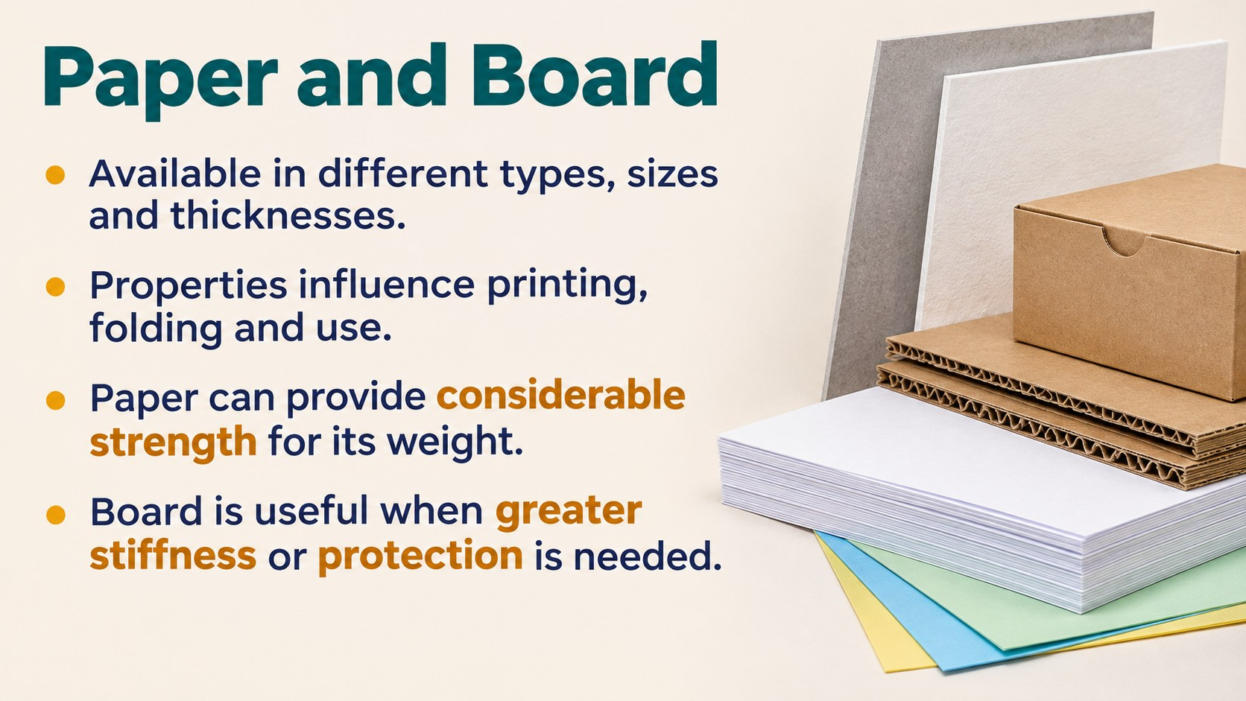
Notes:
Source: Pearson Edexcel GCSE (9–1) Design and Technology revision reference, uploaded as Year 10-11 Pearson Edexcel Design & Technology.pdf, sections 1.8 and 1.9, printed pages 26–30. Classroom adaptation of approved content. Images generated as illustrative teaching visuals. Technical clarifications: magnetism and corrosion vary between ferrous alloys; gsm measures mass per area; hardness differs from impact resistance; polished copper is reddish-brown.

Slide 5
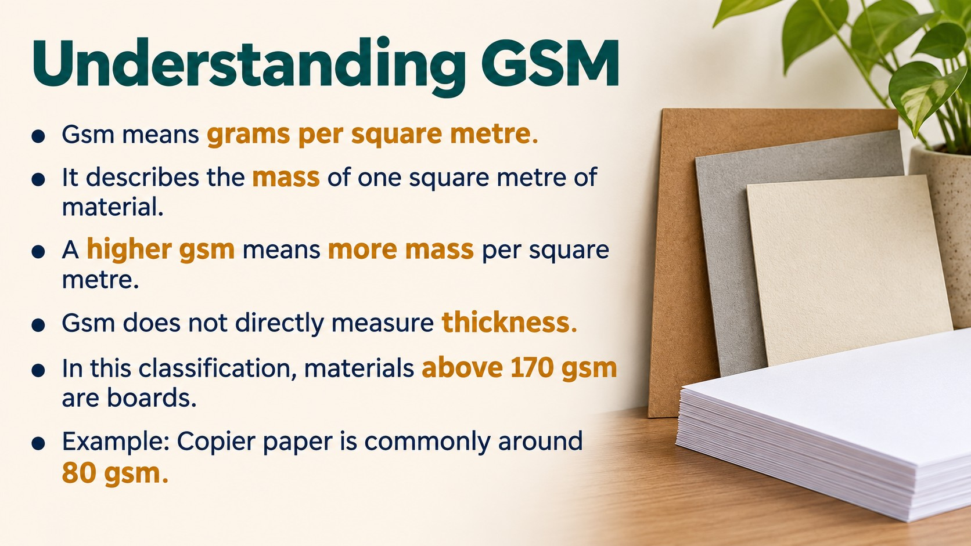
Notes:
Source: Pearson Edexcel GCSE (9–1) Design and Technology revision reference, uploaded as Year 10-11 Pearson Edexcel Design & Technology.pdf, sections 1.8 and 1.9, printed pages 26–30. Classroom adaptation of approved content. Images generated as illustrative teaching visuals. Technical clarifications: magnetism and corrosion vary between ferrous alloys; gsm measures mass per area; hardness differs from impact resistance; polished copper is reddish-brown.

Slide 6

Notes:
Source: Pearson Edexcel GCSE (9–1) Design and Technology revision reference, uploaded as Year 10-11 Pearson Edexcel Design & Technology.pdf, sections 1.8 and 1.9, printed pages 26–30. Classroom adaptation of approved content. Images generated as illustrative teaching visuals. Technical clarifications: magnetism and corrosion vary between ferrous alloys; gsm measures mass per area; hardness differs from impact resistance; polished copper is reddish-brown.

Slide 7
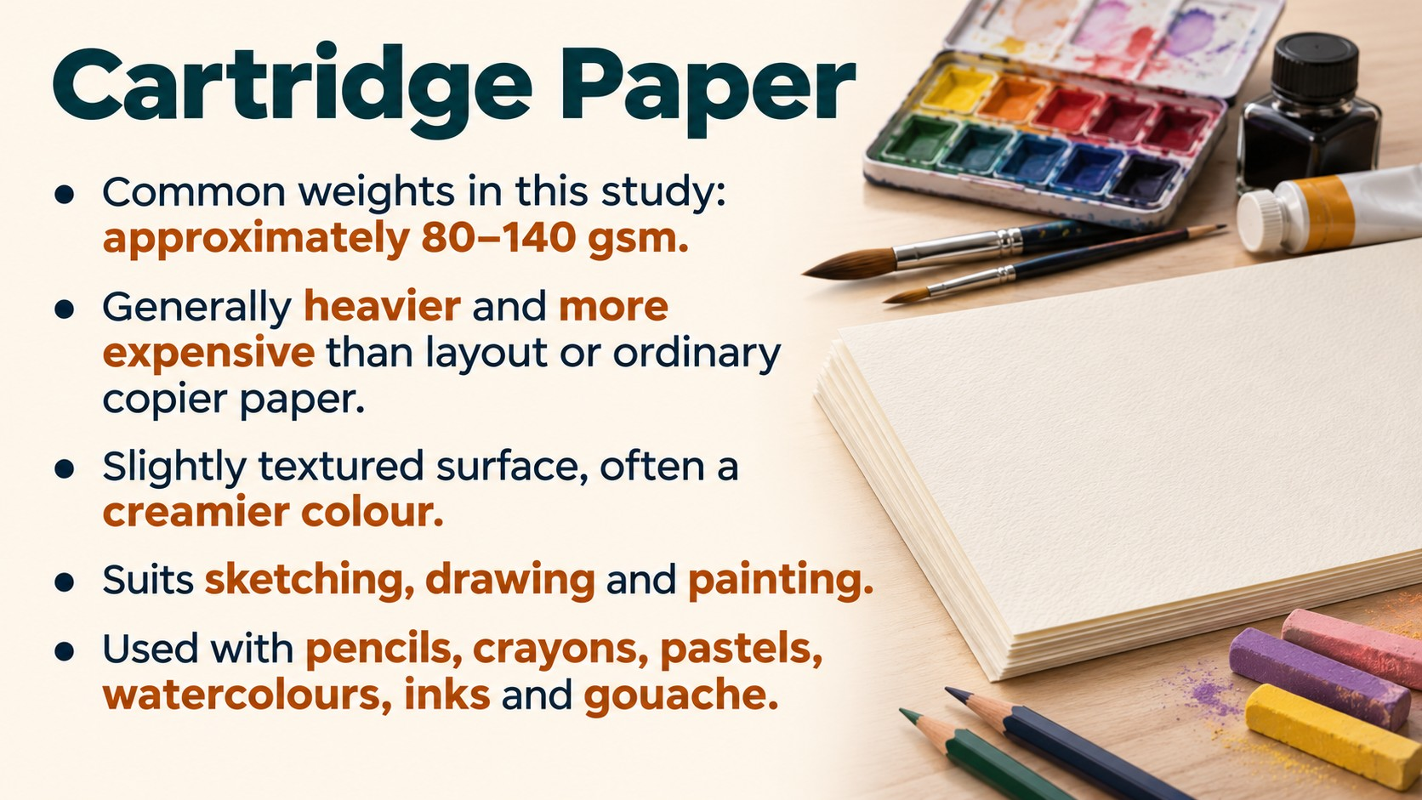
Notes:
Source: Pearson Edexcel GCSE (9–1) Design and Technology revision reference, uploaded as Year 10-11 Pearson Edexcel Design & Technology.pdf, sections 1.8 and 1.9, printed pages 26–30. Classroom adaptation of approved content. Images generated as illustrative teaching visuals. Technical clarifications: magnetism and corrosion vary between ferrous alloys; gsm measures mass per area; hardness differs from impact resistance; polished copper is reddish-brown.

Slide 8
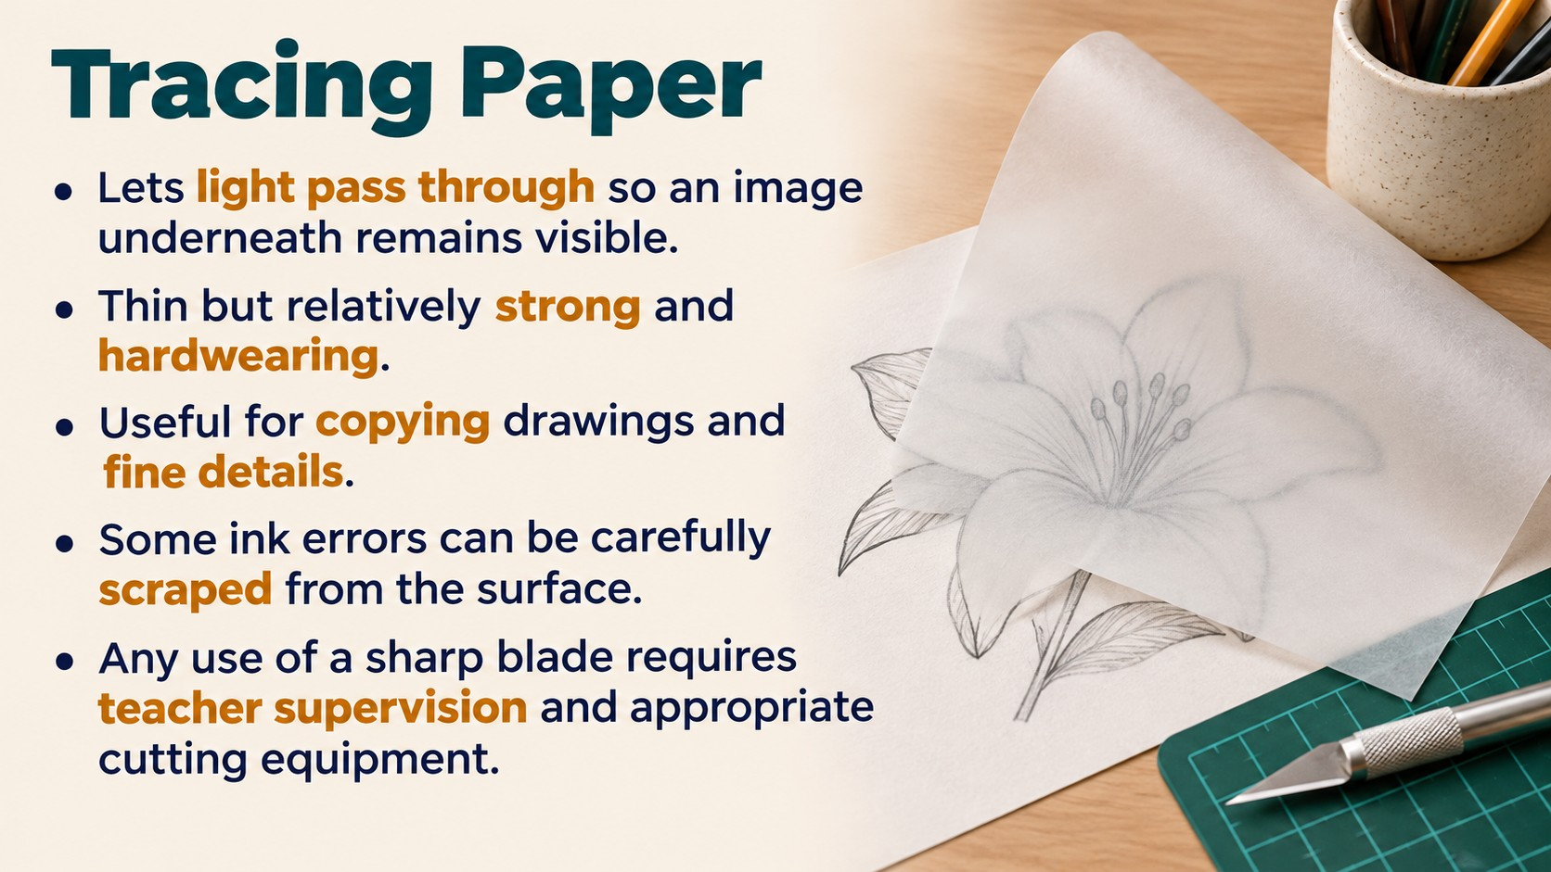
Notes:
Source: Pearson Edexcel GCSE (9–1) Design and Technology revision reference, uploaded as Year 10-11 Pearson Edexcel Design & Technology.pdf, sections 1.8 and 1.9, printed pages 26–30. Classroom adaptation of approved content. Images generated as illustrative teaching visuals. Technical clarifications: magnetism and corrosion vary between ferrous alloys; gsm measures mass per area; hardness differs from impact resistance; polished copper is reddish-brown.

Slide 9
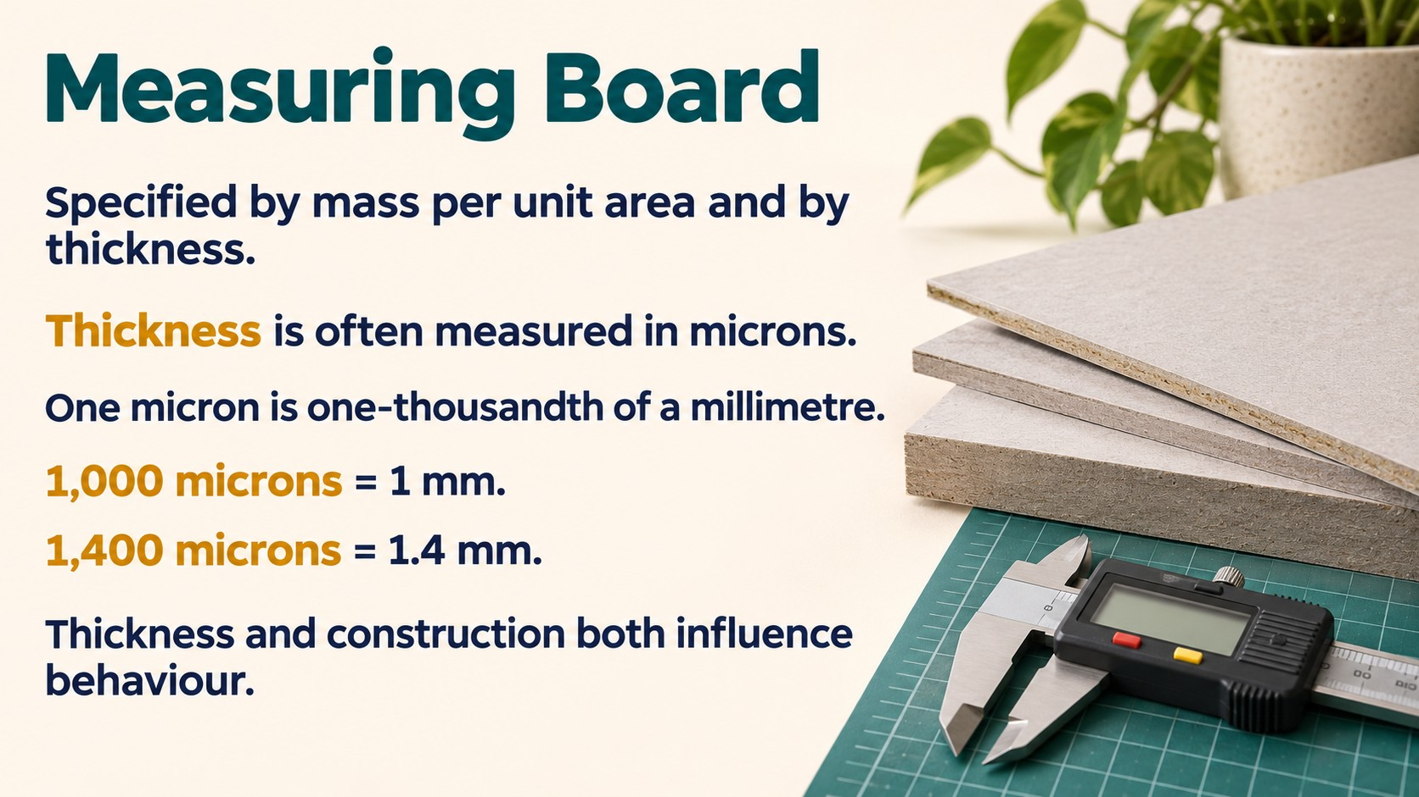
Notes:
Source: Pearson Edexcel GCSE (9–1) Design and Technology revision reference, uploaded as Year 10-11 Pearson Edexcel Design & Technology.pdf, sections 1.8 and 1.9, printed pages 26–30. Classroom adaptation of approved content. Images generated as illustrative teaching visuals. Technical clarifications: magnetism and corrosion vary between ferrous alloys; gsm measures mass per area; hardness differs from impact resistance; polished copper is reddish-brown.

Slide 10
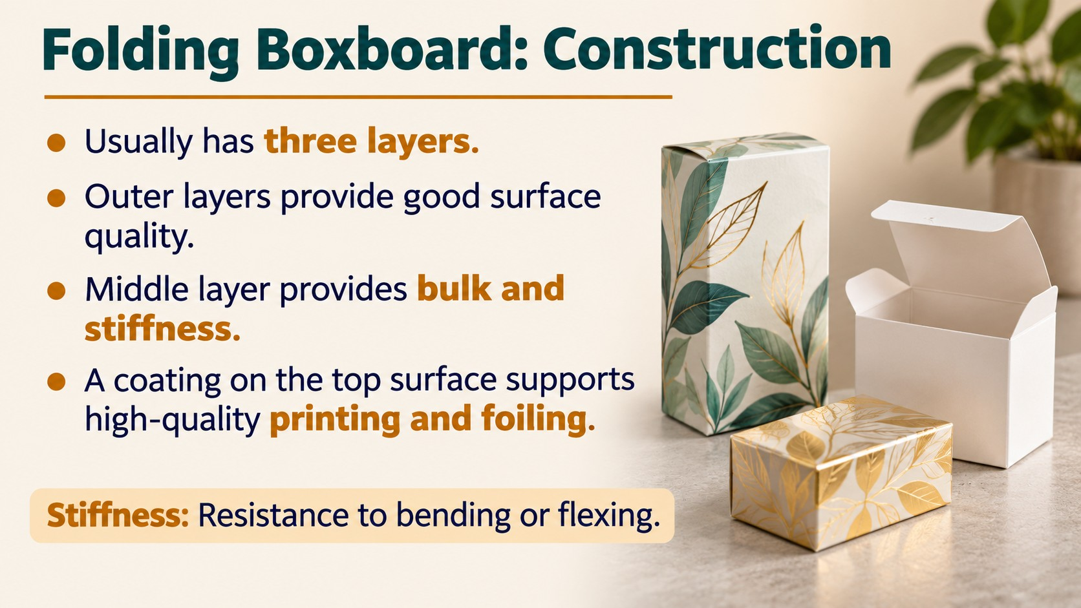
Notes:
Source: Pearson Edexcel GCSE (9–1) Design and Technology revision reference, uploaded as Year 10-11 Pearson Edexcel Design & Technology.pdf, sections 1.8 and 1.9, printed pages 26–30. Classroom adaptation of approved content. Images generated as illustrative teaching visuals. Technical clarifications: magnetism and corrosion vary between ferrous alloys; gsm measures mass per area; hardness differs from impact resistance; polished copper is reddish-brown.

Slide 11

Notes:
Source: Pearson Edexcel GCSE (9–1) Design and Technology revision reference, uploaded as Year 10-11 Pearson Edexcel Design & Technology.pdf, sections 1.8 and 1.9, printed pages 26–30. Classroom adaptation of approved content. Images generated as illustrative teaching visuals. Technical clarifications: magnetism and corrosion vary between ferrous alloys; gsm measures mass per area; hardness differs from impact resistance; polished copper is reddish-brown.

Slide 12
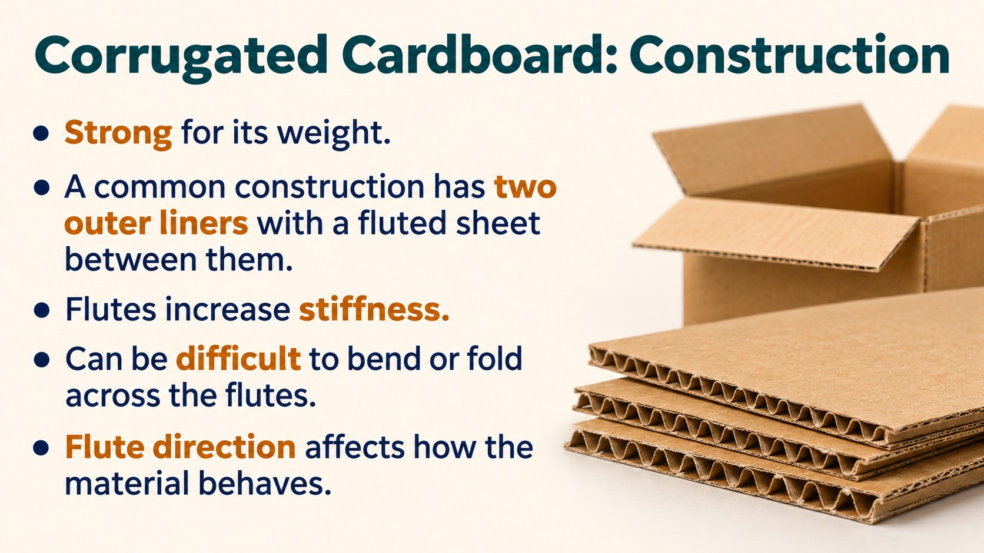
Notes:
Source: Pearson Edexcel GCSE (9–1) Design and Technology revision reference, uploaded as Year 10-11 Pearson Edexcel Design & Technology.pdf, sections 1.8 and 1.9, printed pages 26–30. Classroom adaptation of approved content. Images generated as illustrative teaching visuals. Technical clarifications: magnetism and corrosion vary between ferrous alloys; gsm measures mass per area; hardness differs from impact resistance; polished copper is reddish-brown.

Slide 13
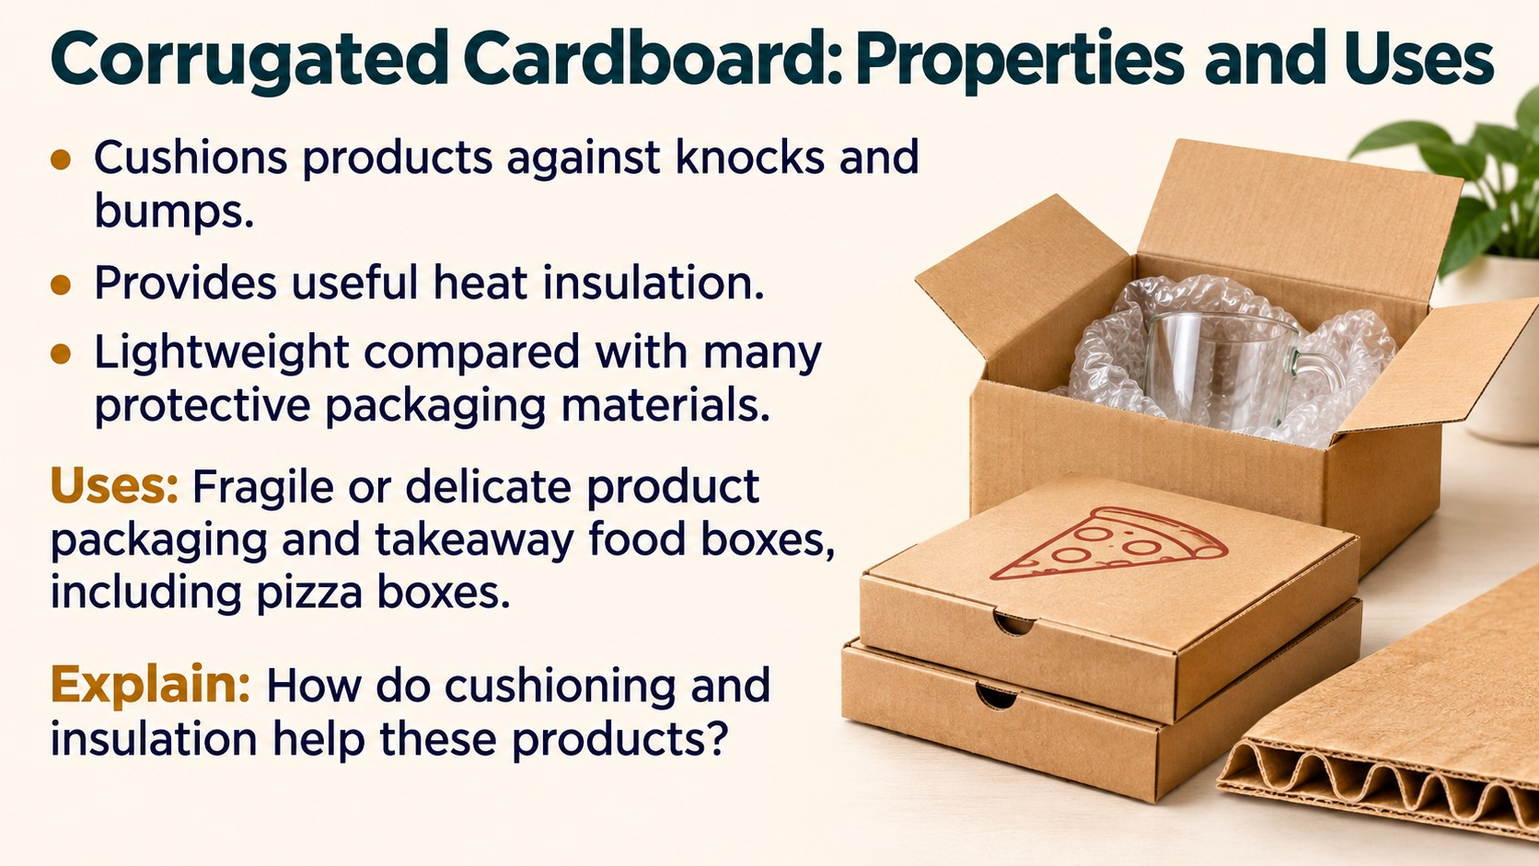
Notes:
Source: Pearson Edexcel GCSE (9–1) Design and Technology revision reference, uploaded as Year 10-11 Pearson Edexcel Design & Technology.pdf, sections 1.8 and 1.9, printed pages 26–30. Classroom adaptation of approved content. Images generated as illustrative teaching visuals. Technical clarifications: magnetism and corrosion vary between ferrous alloys; gsm measures mass per area; hardness differs from impact resistance; polished copper is reddish-brown.

Slide 14
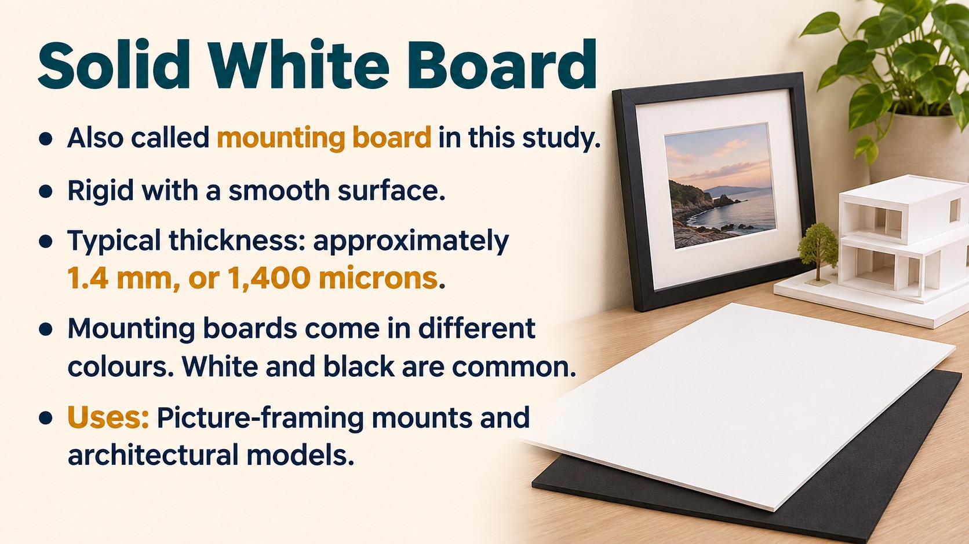
Notes:
Source: Pearson Edexcel GCSE (9–1) Design and Technology revision reference, uploaded as Year 10-11 Pearson Edexcel Design & Technology.pdf, sections 1.8 and 1.9, printed pages 26–30. Classroom adaptation of approved content. Images generated as illustrative teaching visuals. Technical clarifications: magnetism and corrosion vary between ferrous alloys; gsm measures mass per area; hardness differs from impact resistance; polished copper is reddish-brown.

Slide 15
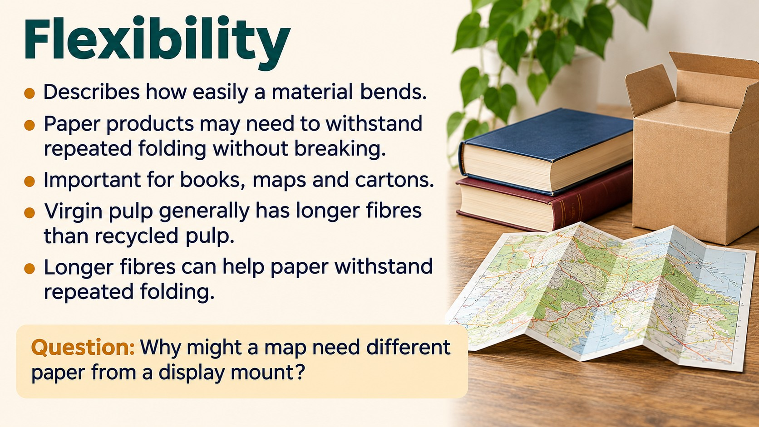
Notes:
Source: Pearson Edexcel GCSE (9–1) Design and Technology revision reference, uploaded as Year 10-11 Pearson Edexcel Design & Technology.pdf, sections 1.8 and 1.9, printed pages 26–30. Classroom adaptation of approved content. Images generated as illustrative teaching visuals. Technical clarifications: magnetism and corrosion vary between ferrous alloys; gsm measures mass per area; hardness differs from impact resistance; polished copper is reddish-brown.

Slide 16
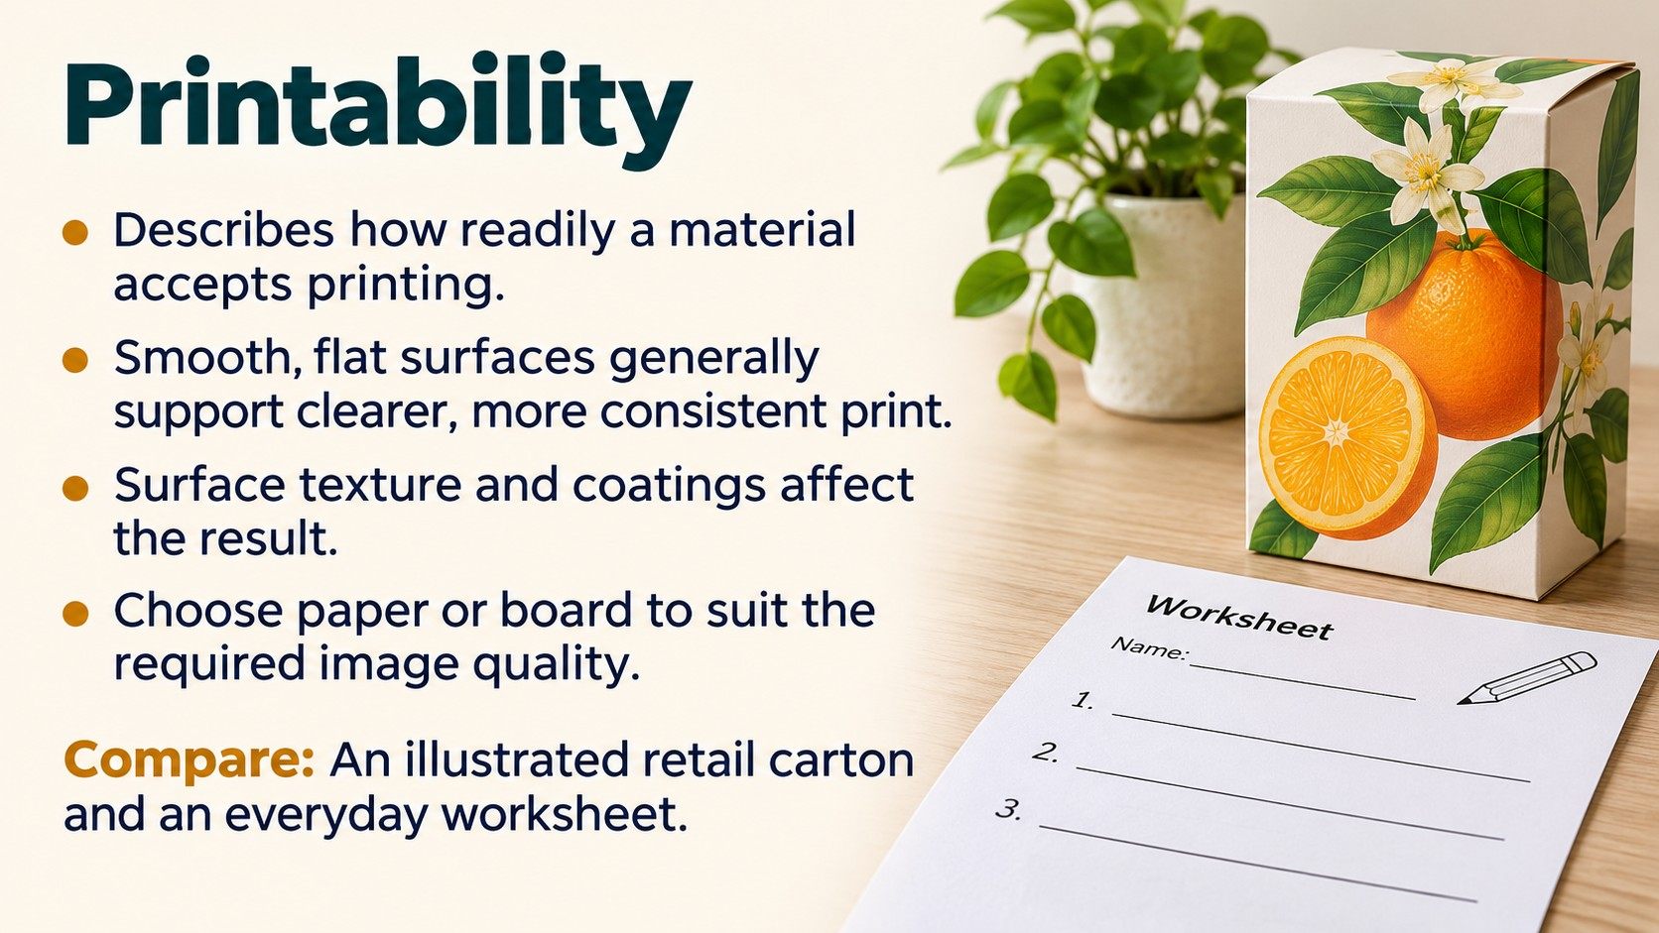
Notes:
Source: Pearson Edexcel GCSE (9–1) Design and Technology revision reference, uploaded as Year 10-11 Pearson Edexcel Design & Technology.pdf, sections 1.8 and 1.9, printed pages 26–30. Classroom adaptation of approved content. Images generated as illustrative teaching visuals. Technical clarifications: magnetism and corrosion vary between ferrous alloys; gsm measures mass per area; hardness differs from impact resistance; polished copper is reddish-brown.

Slide 17

Notes:
Source: Pearson Edexcel GCSE (9–1) Design and Technology revision reference, uploaded as Year 10-11 Pearson Edexcel Design & Technology.pdf, sections 1.8 and 1.9, printed pages 26–30. Classroom adaptation of approved content. Images generated as illustrative teaching visuals. Technical clarifications: magnetism and corrosion vary between ferrous alloys; gsm measures mass per area; hardness differs from impact resistance; polished copper is reddish-brown.

Slide 18

Notes:
Source: Pearson Edexcel GCSE (9–1) Design and Technology revision reference, uploaded as Year 10-11 Pearson Edexcel Design & Technology.pdf, sections 1.8 and 1.9, printed pages 26–30. Classroom adaptation of approved content. Images generated as illustrative teaching visuals. Technical clarifications: magnetism and corrosion vary between ferrous alloys; gsm measures mass per area; hardness differs from impact resistance; polished copper is reddish-brown.

Slide 19
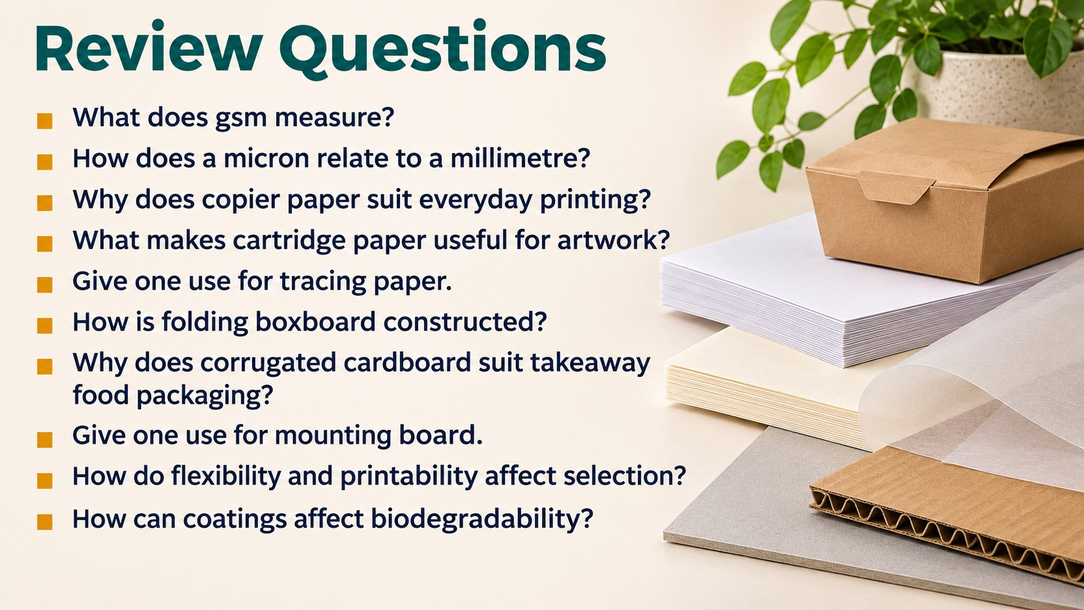
Notes:
Source: Pearson Edexcel GCSE (9–1) Design and Technology revision reference, uploaded as Year 10-11 Pearson Edexcel Design & Technology.pdf, sections 1.8 and 1.9, printed pages 26–30. Classroom adaptation of approved content. Images generated as illustrative teaching visuals. Technical clarifications: magnetism and corrosion vary between ferrous alloys; gsm measures mass per area; hardness differs from impact resistance; polished copper is reddish-brown.

